Slide 1
PowerEnJoy RASD
Flavio Primo | Hootan Haji Manoochehri

Slide 2
Scope & Stakeholders
Scope
Digital management system for car-sharing service that exclusively employs electric cars.
Functionality includes: user registration, search for an available car and renting a car.
Stakeholders
PowerEnJoy company
Users

Slide 3
Glossary
PowerEnJoy company
PowerEnJoy
Agents
Guest
User
Driver
Safe Area
Normal
Special
Payment information
PowerEnJoy car
PowerEnJoy car status
Available
Reserved
In-use
Out-of-Power
PowerEnJoyBox
MaintenanceService

Slide 4
Functional Requirements (Goals)
Allow a guest to register to the platform.
Allow a user to access the platform by logging in.
Allow a user to find an available car.
Allow a user to reserve an available car.
Allow a user to cancel his reservation.
Allow a user to unlock a reserved car.
Allow a user to pick the car up.
Allow a user to pay for the ride.
Allow a user to park in a safe area.
Allow the user to plug the car into the grid.

Slide 5
StoryBoard

Slide 6
Use cases

Slide 7
Use case: Unlocking
Name | Unlocking
Description | User unlocks the car.
Primary Actor | User, PowerEnJoy car
Basic Flow | The PowerEnJoy car detects that the user (with the PowerEnJoy app open) is within 50 meters from the car. The PowerEnJoy car asks the PowerEnJoy app of the user for the authentication code. The PowerEnJoy app shows to the user an “Unlock” button and the user clicks it. The PowerEnJoy app sends back to the PowerEnJoy car the authentication code. The PowerEnJoy car validates the authentication code and if correct: unlocks the car doors. powers on the touchscreen of the PowerEnJoy car with the navigation application. starts the count for the car usage. changes the car status to “In-use” and notifies the system and the PowerEnJoy app that it has been unlocked.
Alternate Flow | /
Exception | /

Slide 8
Use case: Unlocking

Slide 9
FSM

Slide 10
CDD

Slide 11
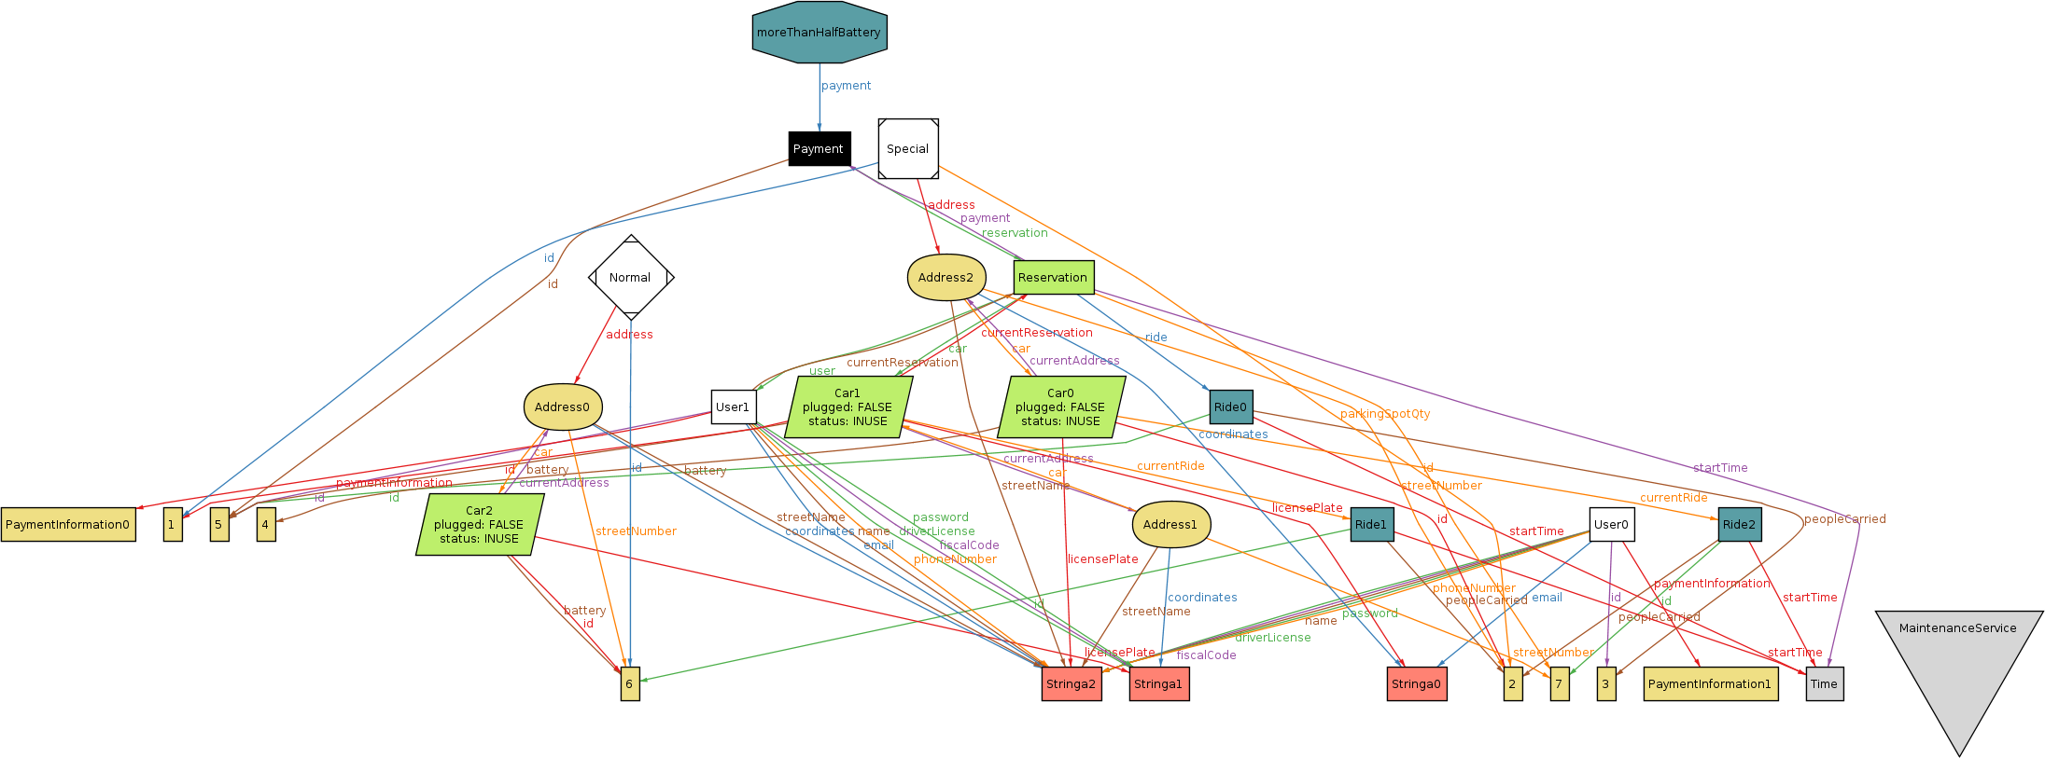
Alloy generated world

Slide 12
Thank you!
Flavio Primo, Hootan Haji Manoochehri
POLITECNICO DI MILANO | SOFTWARE ENGINEERING 2

